Slide 1

Data Engineering: Fueling the Future of Financial Services
“Engineering Tomorrow's Financial Data Today“

Slide 2
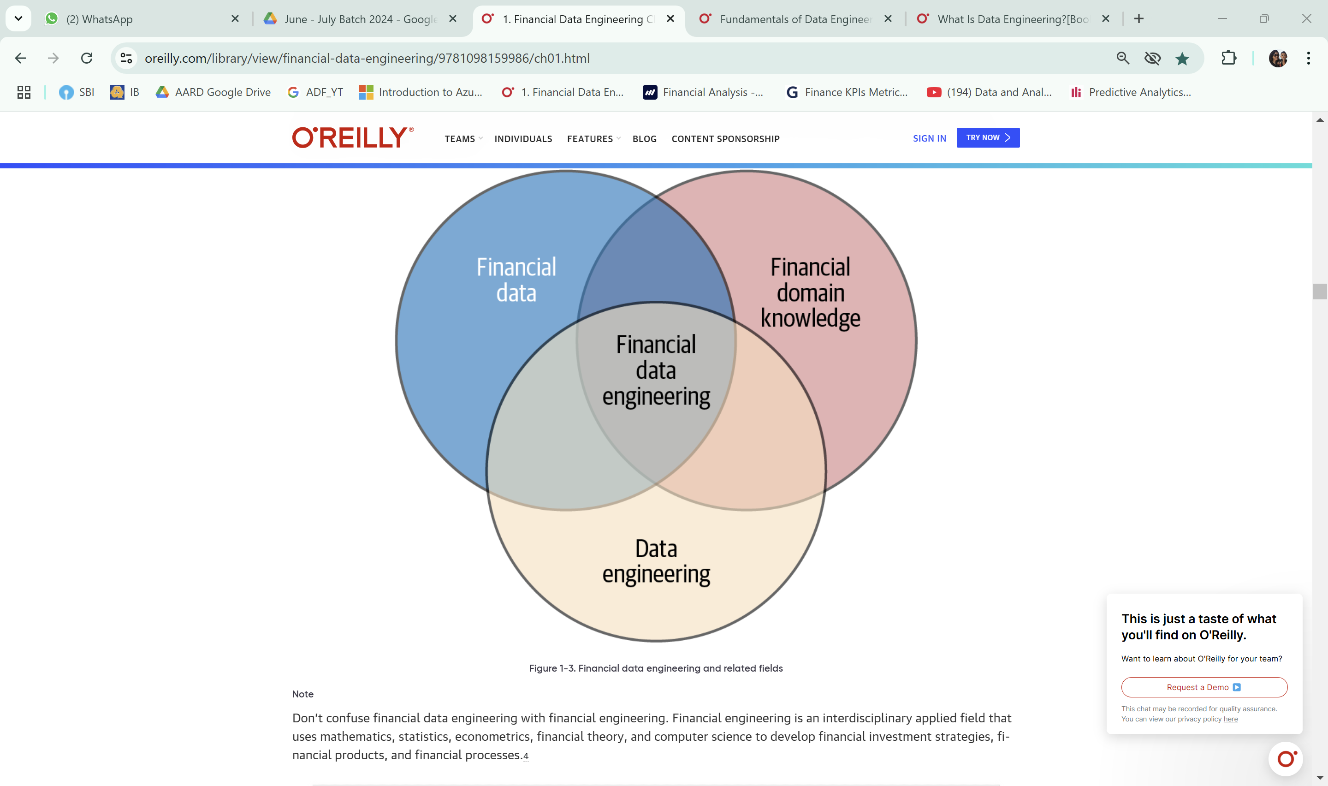

What is Financial Analytics
Financial service covers a wide spectrum of businesses that handle financial matters such as banks, investment firms, insurance companies and real estate services.
It encompasses a range of activities including financial modeling, forecasting, budgeting and performance analysis.
Financial analytics is essential for
Decision-Making
Risk Management
Performance Tracking
Cost Efficiency
Competitive Advantage
Budgeting and Forecasting
Regulatory Compliance

Slide 3



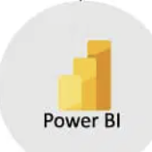



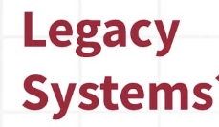







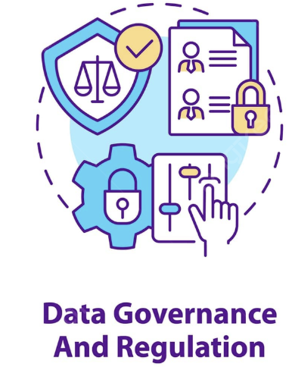


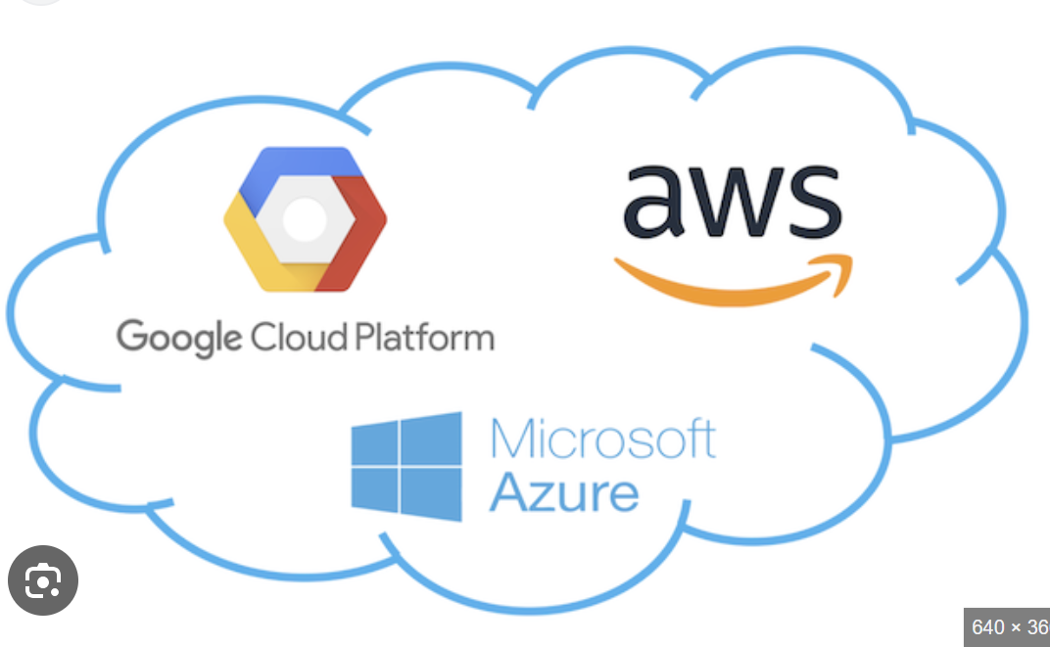





Architectural view of Data Engineering in Financial Services
Source System
Data Ingestion
Batch processing – ETL, Bulk Loading
Real-Time processing - Apache Kafka, Apache Flink, or AWS Kinesis
APIs - RESTful & SOAP
CDC – Debezium or GoldenGate
File Based – FTP, SFTP
Message Queues - Apache Kafka, RabbitMQ, or AWS SQS
DB connectors – JDBC, ODBC
Web Scraping – Selenium, Scrapy
Data Processing
Data Storage
Data Visualisation & Analysis
Data Cleaning
Data Transformation
Data Enrichment
c
c
Security and Compliance
Data Integration
c
c
Data Aggregation
Data Masking
c
Data Indexing
Business Applications
Ratio Analysis
Predictive Analytics
Trend Analysis
Cash Flow Analysis
Benchmarking
Regression Analysis
Data Validation
Notes:
Components Explained
1. Data Sources: This includes all the raw data collected from various sources such as transactions, market trends, customer interactions, social media, and external databases.
2. Data Ingestion Layer: This layer is responsible for the initial collection and loading of data into the system. It involves ETL processes, data pipelines, and real-time data streaming technologies like Apache Kafka.
3. Data Storage and Management: Once ingested, data is stored in data warehouses (e.g., Amazon Redshift, Google BigQuery) or data lakes (e.g., Hadoop, Azure Data Lake). This layer ensures data is organized, secure, and easily retrievable.
4. Data Processing Layer: This involves both batch and real-time processing of data. Tools like Apache Spark handle batch processing, while Flink or Storm manage real-time data processing, enabling timely analysis and decision-making.
5. Data Analysis Layer: Here, machine learning models (e.g., using scikit-learn, TensorFlow) and statistical analysis (e.g., using R, Python) are applied to interpret data, extract insights, and make predictions.
6. Data Visualization: Visualization tools like Tableau and Power BI create dashboards and reports, transforming raw data into understandable and actionable insights.
7. Business Applications: The insights derived from data analysis are applied to various business functions, including fraud detection, credit risk assessment, customer segmentation, investment strategies, and compliance reporting.

Slide 4
Data Flow of Data Engineering in Financial Services
This shows a seamless flow from raw data collection to actionable business insights, enabling financial institutions to make data-driven decisions effectively. The final data is used for data governance & for business application to support various financial operations, enhance customer experiences, and enable regulatory compliance
Data Sources
Extract structured data like SQL, files (CSV, Excel), and legacy or unstructured data like IoT, web, apps, and social media, which have transactional, market, customer, and social media data.
Data Ingestion Layer
Create efficient pipelines to collect and ingest this data, ensuring it is accurate, timely, and reliable
Data Analysis Layer
Machine learning models and statistical analysis are applied here to interpret data, extract insights, and make predictions.
Data Visualization
It helps to transform raw data into understandable and actionable insights & reporting purpose
Data Governance
Software or Tools used adhere to security & Compliance, to follow GDPR and to maintain data security
Business Applications
The insights derived from data analysis are applied to various business functions like,
> Customer Segmentation
> Investment Strategies
> Compliance Reporting
> Fraud Detection System
> Credit Risk Assessment
Data Processing layers
This involves both batch and real-time processing of data to manage real-time data processing, enabling timely analysis and decision-making.
Data Storage & Management
The data is stored in a data warehouse after being cleaned, transformed, and organized securely for easy retrieving from a data warehouse.
Notes:
Components Explained
1. Data Sources: This includes all the raw data collected from various sources such as transactions, market trends, customer interactions, social media, and external databases.
2. Data Ingestion Layer: This layer is responsible for the initial collection and loading of data into the system. It involves ETL processes, data pipelines, and real-time data streaming technologies like Apache Kafka.
3. Data Storage and Management: Once ingested, data is stored in data warehouses (e.g., Amazon Redshift, Google BigQuery) or data lakes (e.g., Hadoop, Azure Data Lake). This layer ensures data is organized, secure, and easily retrievable.
4. Data Processing Layer: This involves both batch and real-time processing of data. Tools like Apache Spark handle batch processing, while Flink or Storm manage real-time data processing, enabling timely analysis and decision-making.
5. Data Analysis Layer: Here, machine learning models (e.g., using scikit-learn, TensorFlow) and statistical analysis (e.g., using R, Python) are applied to interpret data, extract insights, and make predictions.
6. Data Visualization: Visualization tools like Tableau and Power BI create dashboards and reports, transforming raw data into understandable and actionable insights.
7. Business Applications: The insights derived from data analysis are applied to various business functions, including fraud detection, credit risk assessment, customer segmentation, investment strategies, and compliance reporting.

Slide 5
Analytics in Financial Services: Bridging the Past, Present, and Future
Descriptive Analytics
Purpose: To summarize and describe historical data.
Example: Identifying the root causes of financial performance issues or operational inefficiencies.
Predictive Analytics
Purpose: To forecast future events based on historical data.
Example: Predicting credit risk using historical data to determine the likelihood of a customer defaulting on a loan.
Prescriptive Analytics
Purpose: To recommend actions based on data analysis.
Example: Suggesting investment strategies to optimize portfolio performance based on risk tolerance and market conditions.
Diagnostic Analytics
Purpose: To understand the reasons behind past events.
Example: Identifying the root causes of financial performance issues or operational inefficiencies.
Customer Analytics:
Purpose: To gain insights into customer behaviour and preferences.
Example: Segmenting customers based on their transaction history to create targeted marketing campaigns.
Operational Analytics:
Purpose: To improve the efficiency of business operations.
Example: Monitoring transaction processing times to identify and address bottlenecks in the process
Regulatory and Compliance Analytics:
Purpose: To ensure compliance with financial regulations.
Example: Monitoring transactions for suspicious activities to comply with anti-money laundering (AML) regulations.
Investment Analytics:
Purpose: To analyze and optimize investment portfolios.
Example: Assessing the performance and risk of investment portfolios to make informed investment decisions.

Slide 6
Metrics in Financial Services
Metrics in financial services are essential for evaluating financial services' performance, health, and efficiency. Here are some key metrics commonly used in the industry:
Types of Financial Metrics
Profit Measures & Profitability Ratio
Capital Market Ratio
Solvency Ratio
Liquidity Ratio
Cash Flow Measures
Net Profit Margin
Return of Assest
Return of Equity
Price-to_Earning (P/E) Ratio
Dividend Yield
Market-to-Book Ratio
Debt-to-Equity Ratio
Interest Coverage Ratio
Equity Ratio
Current Ratio
Quick Ratio (Acid Test Ratio)
Cash Ratio
Operating Cash Flow
Free Cash Flow
Cash Flow per Share

Slide 7

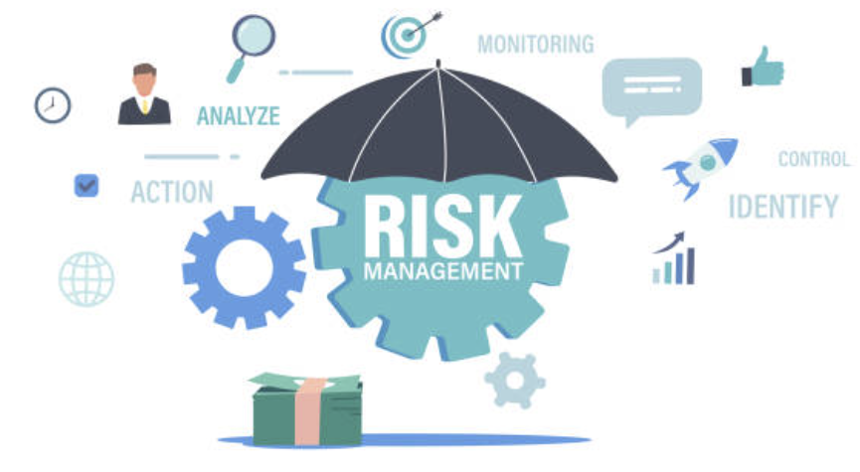



Reshaping Financial Services using Data Engineering
 | Improving Customer Experience | Customer Sentiment Analysis Personalized Financial Services
 | Enhancing Risk Management | Fraud Detection Market Risk Analysis
 | Public Financial Management | Economic Forecasting Targeted Financial Interventions
 | Improving Decision-Making | Credit Risk Assessment Investment Strategies
 | Optimizing Operations and Reducing Costs | Resource Allocation Process Automation

Slide 8
Problems Solved by Data Engineering in Financial Services
Data Silos
& Integration
----------------------
Problem: Financial institutions often have data stored in different systems, making it difficult to integrate and analyze.
--------------------------
Solution: Data engineers use ETL (Extract, Transform, Load) processes to consolidate data from multiple sources into a centralized data warehouse. Techniques like data mapping and data transformation ensure seamless integration.
Slow Data Analysis Times
-------------------------
Problem: Some Financial Services still use Legacy systems and unconnected data sources lead to slow analysis times.
--------------------------
Solution: Implementing real-time data processing and streaming data pipelines using tools like Apache Kafka and Apache Flink. This allows for faster data analysis and real-time insights.
Manual Data Gathering and Tracking
-----------------------
Problem: Manual data gathering and tracking processes are time-consuming and prone to errors.
-----------------------
Solution: Automating data collection and tracking using machine learning algorithms and data automation tools. This reduces manual effort and improves accuracy.
Lack of Executive Analytical Insight
-----------------------
Problem: Executives don’t get a hold on timely and actionable insights/metrics trends.
------------------------
Solution: Developing dashboards and reporting tools using BI platforms like Tableau and Power BI.
Regulatory Compliance
------------------------
Problem: Financial institutions must comply with various regulatory requirements, which can be challenging to manage.
--------------------------
Solution: Implementing data governance frameworks and regulatory reporting tools to ensure compliance. Techniques like data lineage tracking and audit trails help in maintaining transparency and accountability.
Customer Experience Enhancement
-----------------------
Problem: Providing personalized and efficient customer service is essential for customer retention.
--------------------------
Solution: Leveraging customer data platforms (CDPs) and personalization engines to analyze customer behavior and preferences. This enables financial institutions to offer tailored services and improve customer satisfaction.

Slide 9
Business and End User Benefits
Business Benefits:
Improved Decision-Making:
Techniques/Models: Business Intelligence (BI) Tools, Data Warehousing, ETL Processes.
Enhanced Operational Efficiency:
Benefit: Automating data processes reduces manual effort and increases efficiency.
Techniques/Models: Automated Data Pipelines, Real-Time Data Processing.
Risk Management:
Benefit: Identifying and mitigating risks through advanced analytics.
Techniques/Models: Predictive Analytics, Risk Assessment Models, Anomaly Detection Algorithms.
Regulatory Compliance:
Benefit: Ensuring compliance with regulatory requirements through robust data governance.
Techniques/Models: Data Governance Frameworks and Reporting Tools.
Benefit: Data engineering enables businesses to make informed decisions based on accurate and comprehensive data.

Slide 10
Business and End User Benefits
End User Benefits:
Personalized Financial Services:
Benefit: Providing tailored financial products and services based on individual needs.
Techniques/Models: Customer Data Platforms (CDPs), Personalization Engines.
Faster Transaction Processing:
Benefit: Improving the speed and reliability of financial transactions.
Techniques/Models: Real-Time Data Processing, High-Frequency Trading Algorithms.
Fraud Prevention:
Benefit: Protecting customers from fraudulent activities.
Techniques/Models: Fraud Detection Models, Machine Learning Algorithms.
Improved Financial Planning:
Benefit: Helping customers make better financial decisions through insightful analytics.
Techniques/Models: Financial Planning Tools, Predictive Analytics.

Slide 11



Use cases for Financial Analytics
Revenue Forecasting Implementation
Customer Segmentation and Targeting Implementation
Gather historical sales data, market trends, and economic indicators to predict future revenue trends and to guide budgeting, planning, and strategy development.
Collect customer data, including demographics, behaviour, and preferences to develop targeted marketing strategies based on customer segments.
Expense management
To collect data on expense from various sources, such as invoices, receipts & financial statements to optimise budgets & minimize expenses.
Tools Used:
Microsoft Excel: For data cleaning, preprocessing, and initial analysis.
Power BI: For creating interactive dashboards and visualizing expense data.
SAP Concur: For automating expense management and integrating data from various sources.
Tableau: For detailed analysis and reporting.
Tools Used:
R: For statistical modeling and revenue forecasting.
Microsoft Excel: For data cleaning and preprocessing.
Tableau: For visualizing revenue forecasts and presenting insights.
Anaplan: For financial planning and performance management.
Tools Used:
Python: For data cleaning, preprocessing, and implementing clustering algorithms.
SQL: For data collection and manipulation.
Power BI: For visualizing customer segments and their characteristics.
Salesforce: For managing customer data and implementing targeted marketing campaigns.

Slide 12
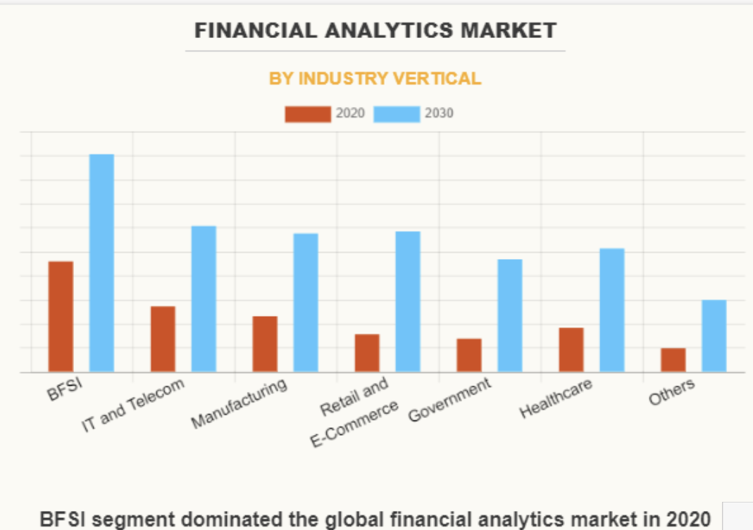
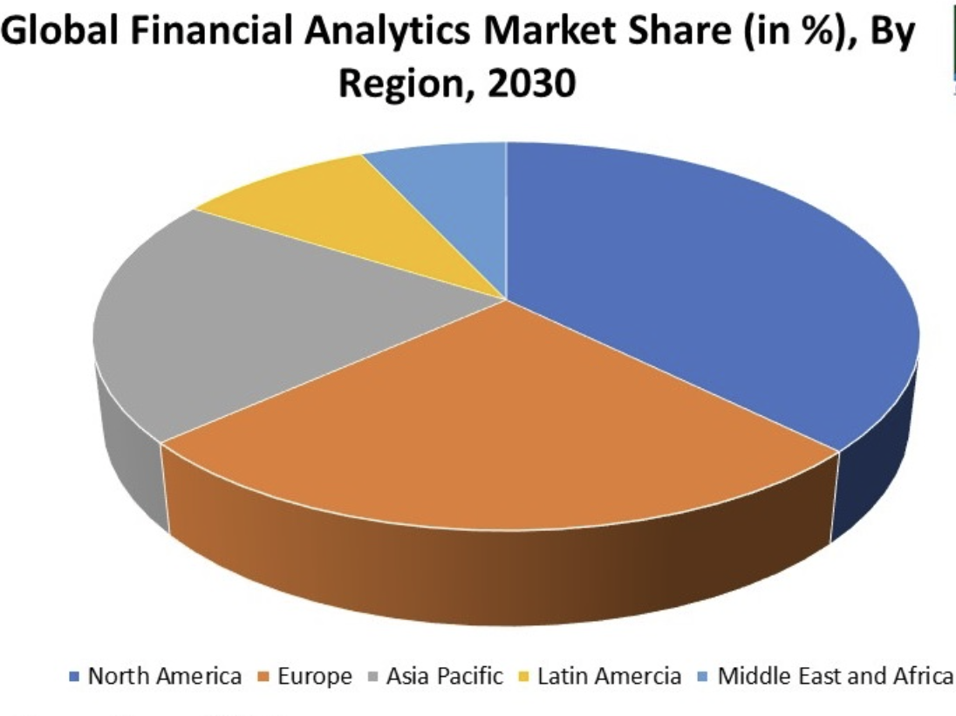
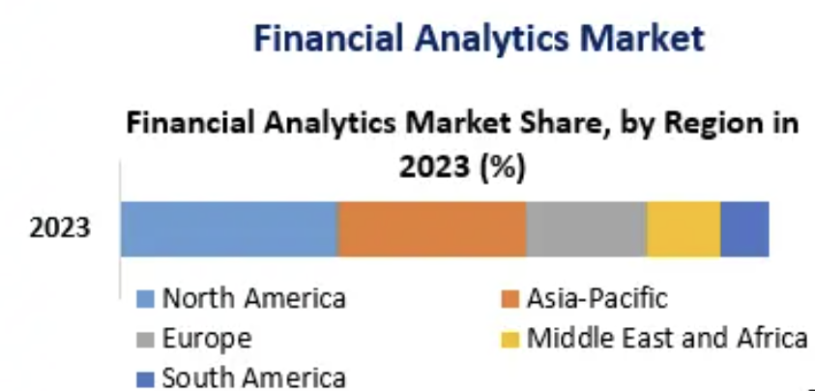
Growth of Financial Analytics
KEY INDUSTRY DEVELOPMENTS:
Date | Company | Development
June 2023 | MICROSTRATEGY INCORPORATED | Partnership with Microsoft's Azure OpenAI Service to enable enterprises to harness the full potential of their data.
May 2023 | QlikTech International AB | Acquired Talend Inc. to expand capabilities in data quality, transformation, application connectivity, and API services.
February 2023 | Alteryx | Launched self-service and enterprise-grade functions to its analytics cloud platform, aiding faster business decisions.
October 2022 | Oracle | Announced new product innovations across its data and analytics solutions portfolio, providing access to prebuilt KPIs, dashboards, and reports.
November 2022 | IBM Corporation | Launched the latest software to break down data and analytics silos, making data-driven decisions faster.
Financial Analytics Market size is valued at USD 9.73 billion and set to exceed USD 40.53 billion by 2037. expanding at over 11.6% CAGR.

Slide 13





Top Data Engineers leads in Financial Services
Name | Position | Company | Key Contributions
Michael Abbott | Senior Managing Director and Global Banking Lead |  | Focuses on digital transformation and industry disruption
Sankar Krishnan | Executive Vice President and Head of Digital Capital Markets |  | Extensive experience in corporate and transaction services banking
Priya Bajoria | Senior Vice President of Financial Services |  | Pioneering the adoption of cutting-edge technologies to revolutionize customers' banking experience
Ken Joseph | Managing Director of Financial Services Compliance and Regulation |  | Provides invaluable guidance to clients in navigating complex regulatory landscapes
Jon Mansley | Head of Data, Analytics & Insight |  | Leading innovative change in the insurance sector by bringing customer insights to the forefront

Slide 14







Top Financial Analytics Companies
Company | Description
 | A data and technology solutions provider for investment professionals, offering financial data and analytics.
 | Offers investment research, data, and analytics to investors, financial advisors, and institutions worldwide.
 | Provides global financial information, analytics, data, research, and ratings to help investors make informed decisions.
 | Known for credit scoring services and provides analytics and decision management solutions.
 | Provides a fintech platform for accepting payments in-app, online, or in-person, optimizing revenue and preventing fraud.
 | Offers a diverse array of financial data, indices, and trading platforms.
 | Provides global interest rate data and derivative pricing.

Slide 15
Final Thoughts "Data engineering is the unsung hero of data science, the foundation upon which great data analysis is built." – Andrew Brust, the founder and CEO of Blue Badge Insights
In short, Data Engineering plays a crucial role in financial services. Data engineering contributes by:
Revolutionizing financial services by improving data collection, transformation, storage, and management.
Enhances decision-making, risk management, and operational efficiency.
Enables real-time fraud detection, optimized trading systems, personalized financial products, and regulatory compliance.
Integrates predictive, prescriptive, and diagnostic analytics, despite challenges and limitations.
Helps the financial sector navigate complexities, drive growth and innovation, and provide better services.
The role of data and data analysts will grow significantly, marking a new era in financial services,

